Slide 1
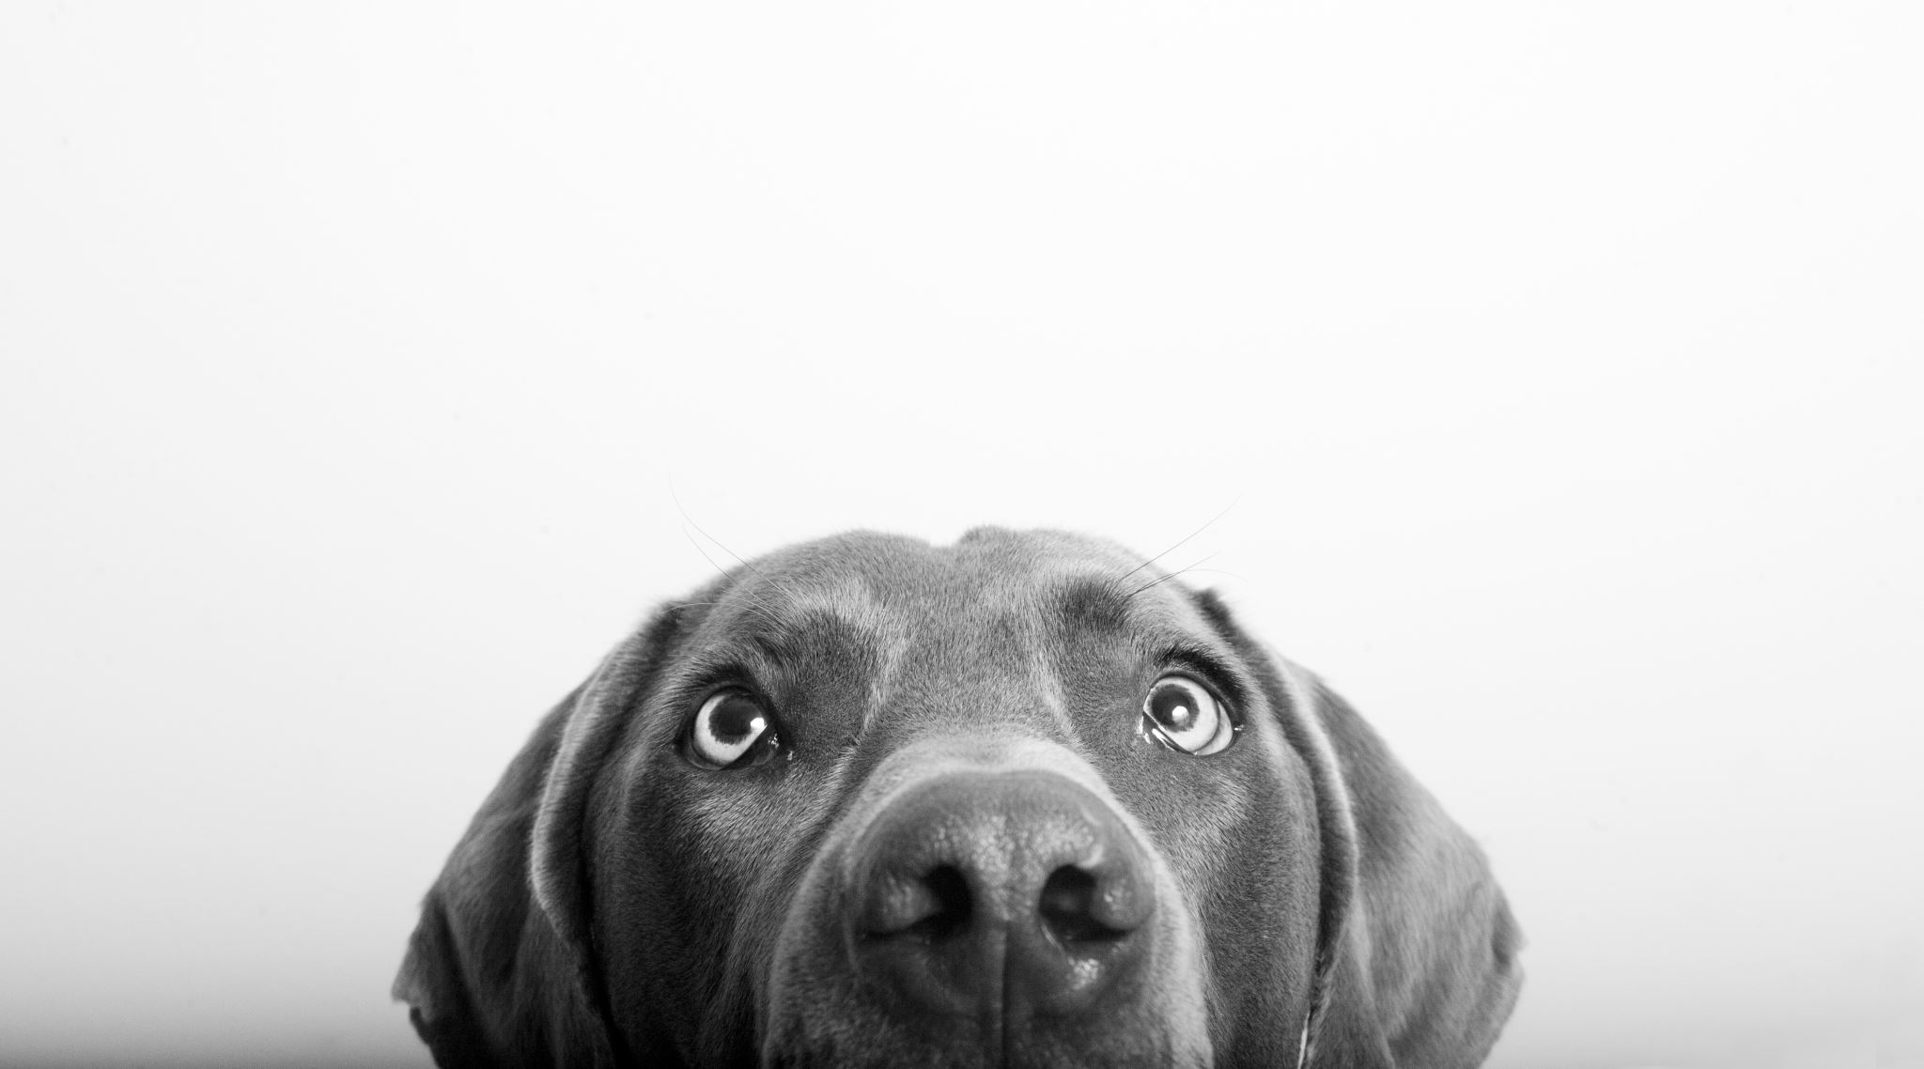
Dog Age Classification Using Deep Learning
LOU Shangzhi
TEAM MEMBERS
ABIN THOMAS
GEETHU SAMEELA
LOU SHANGZHI

Slide 2
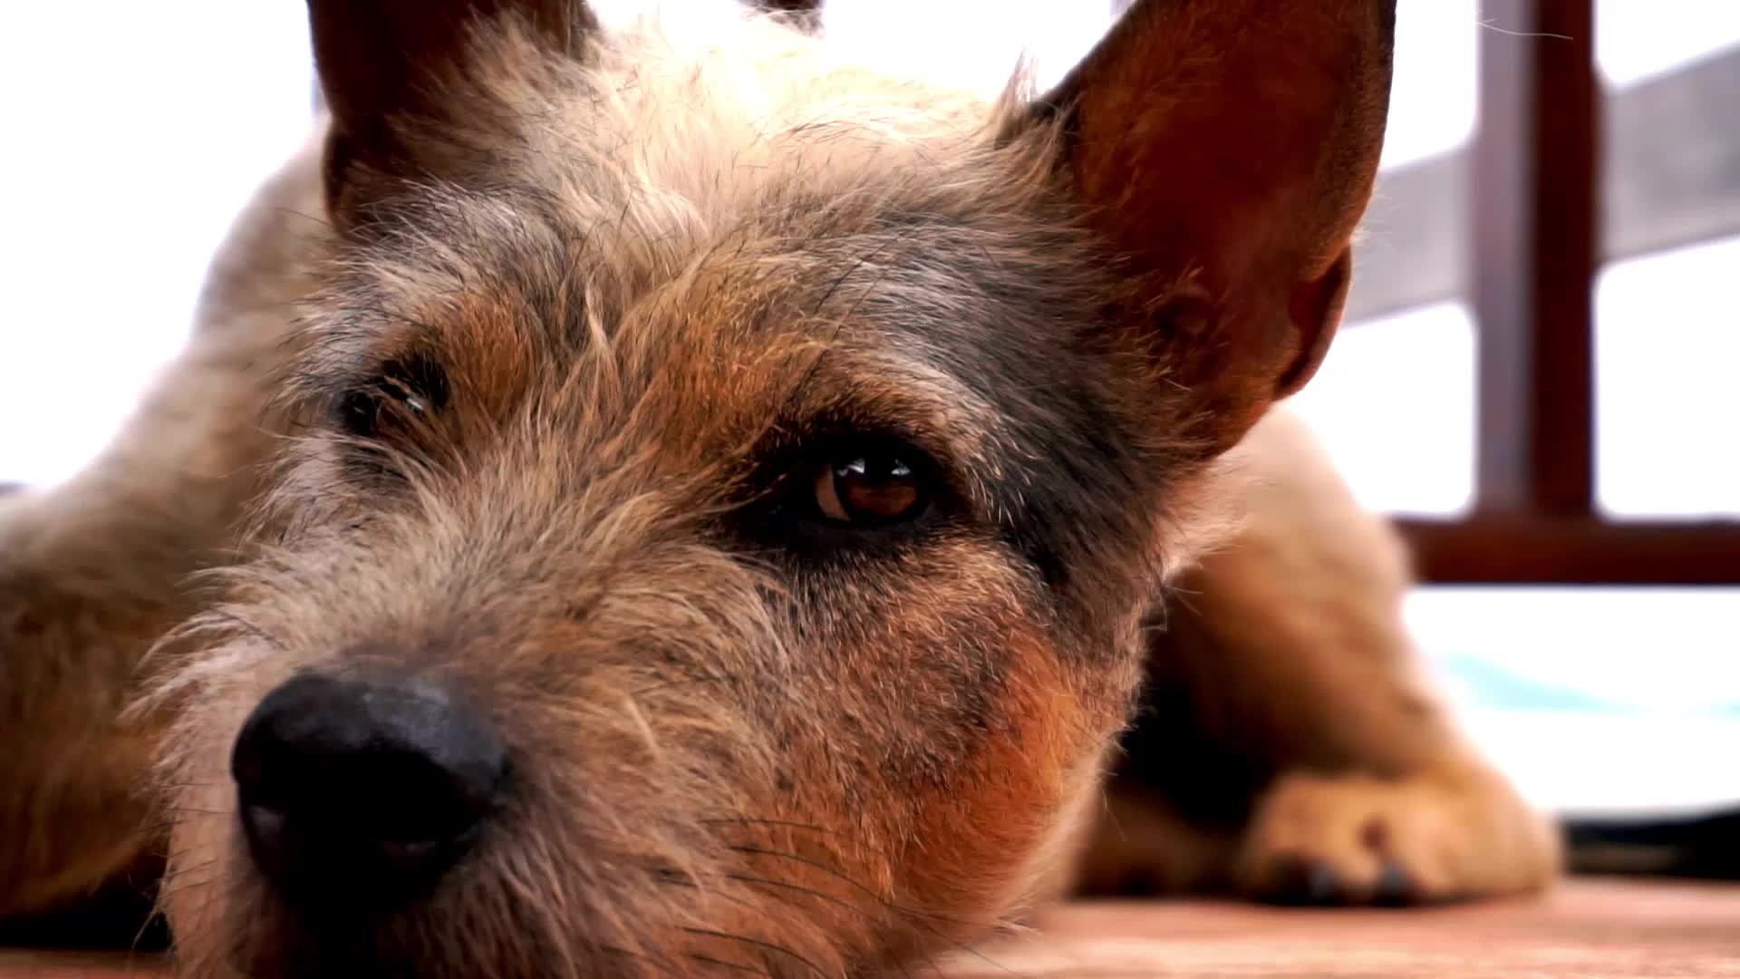
Objective
The problem is to classify dog age groups into three categories: "Adult," "Senior," and "Young" based on images. The classification model is designed to automatically predict the age category of a dog based on an image, which can be helpful for veterinary applications or other related fields.

Slide 3
Dataset Overview
Description of the dataset
Source: Dog age dataset
Categories: Adult, Senior, Young
Total images:
Adult: 370 images
Senior: 495 images
Young: 223 images

Slide 4
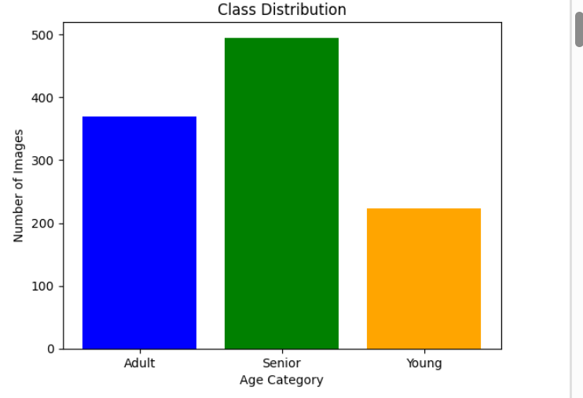
Data Visualization

Slide 5
Data processing
Load Images
Resize to 128x128
Normalize Pixel Values
One-Hot Encoding of Labels

Slide 6

Model Architecture
Overview of the model used:
Type: Convolutional Neural Network (CNN)
Layers:
Conv2D layers for feature extraction
MaxPooling2D layers for down-sampling
Dropout layers for regularization
Dense layers for classification
A softmax output layer for multi-class classification.

Slide 7
Flow chart
Input Image
Conv2D Layer
MaxPooling2D
Dropout
Conv2D Layer
MaxPooling2D
Dropout
Flatten
Dense Layer
Output (Softmax)

Slide 8
Model Training
Training parameters:
Optimizer: Adam
Loss function: Categorical Crossentropy
Number of epochs: 10
Batch size: 32
Training and validation accuracy over epochs

Slide 9
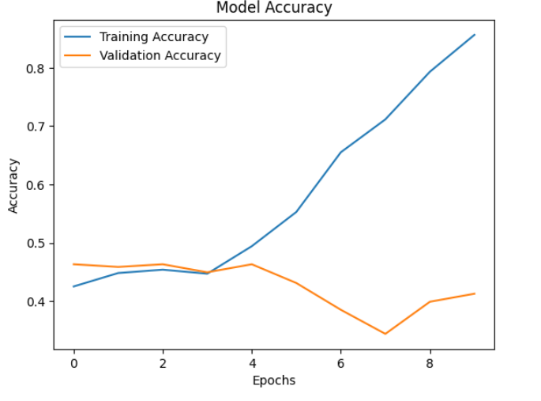
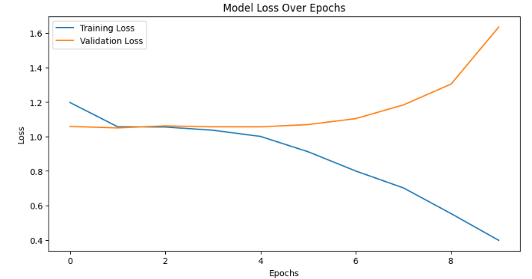
Model Evaluation
Test accuracy: 41.28%
Confusion matrix to visualize model performance
Discussion on model strengths and weaknesses

Slide 10
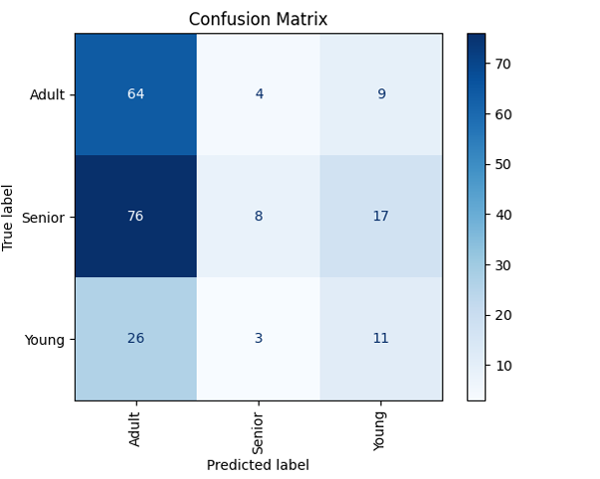
Results Visualization

Slide 11
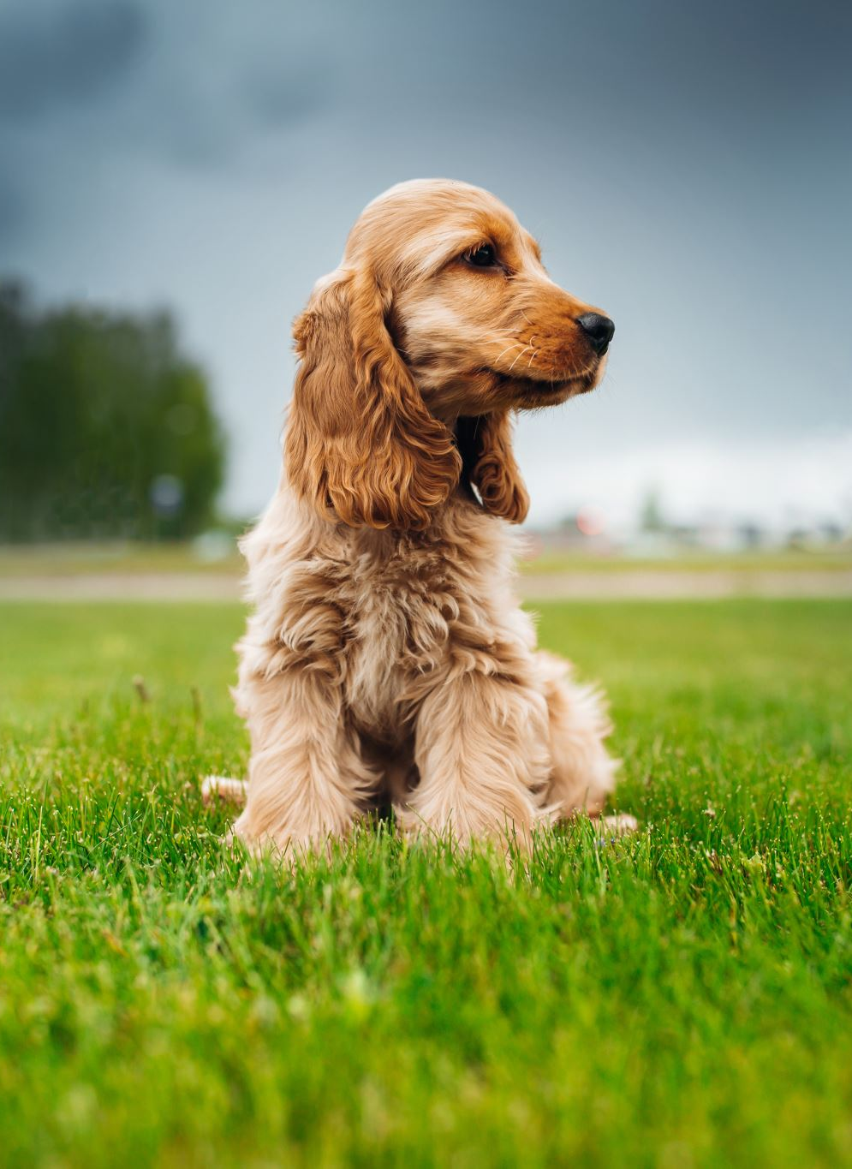
Conclusion for stag1
Developed a deep learning model to classify dog age groups into "Young," "Adult," and "Senior" based on images.
This solution enhances efficiency in veterinary applications by automating age prediction, demonstrating the potential of AI in pet care.
Future work includes expanding the dataset and integrating the model into real-world applications for broader usability.

Slide 12
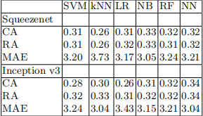
Paper and other works
We tried different combinations based on two different CNN architectures: SqueezeNet and Inception v3, and 6 different well-known classifiers: KNN, SVM, Logistic Regression (LR), Naive Bayes(NB), Random Forest (RF) and feed forward neural network (NN).
Zamansky A, Sinitca A M, Kaplun D I, et al. Automatic Estimation of Dog Age: The DogAge Dataset and Challenge Announcement[J].

Slide 13
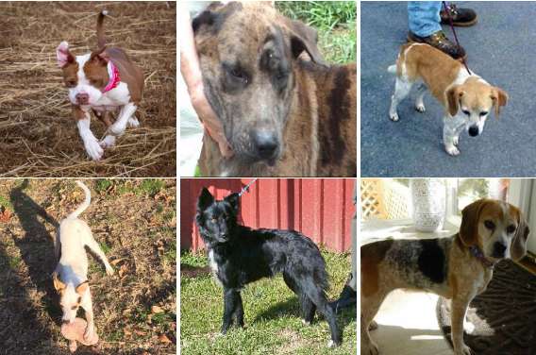
Data Preprocessing
Data Splitting:
The dataset is split into training, validation, and testing sets using stratified sampling.(20% holdout was performed, and then from that 20% holdout, 50% of that was used for validation, and the rest was used for testing.)
Data Augmentation
Shifts, scaling, rotations, flips, color jitter, normalization to enhance model generalization.
Face Detection: OpenCV's Haar cascade classifier is used to detect and crop dog faces from the images.

Slide 14
Model Selection
Lightweight Models:
MobileNetV2: Optimized for resource-constrained environments.
EfficientNet-B0: Balances accuracy and efficiency.
ResNet18: Provides high performance, while remaining relatively small.
Model Modification: The last layer of each model is replaced with a dropout layer and a linear layer with three output nodes for the classification task.

Slide 15
Model Training and Evaluation
Loss Function: Cross-Entropy Loss
Optimizer: Adam Optimizer
Learning Rate Scheduler: ReduceLROnPlateau for dynamic learning rate adjustment
Training Loop: Training process with forward pass, loss calculation, backpropagation, and validation.
Training Epochs: 20 epochs.
Model Weight Saving: The model weights for the best validation performance
Evaluation Metrics: Accuracy, precision, recall, F1-score, and confusion matrix.

Slide 16
Model Training and Evaluation
Loss Function: Cross-Entropy Loss
Optimizer: Adam Optimizer
Learning Rate Scheduler: ReduceLROnPlateau for dynamic learning rate adjustment
Training Loop: Training process with forward pass, loss calculation, backpropagation, and validation.
Training Epochs: 20 epochs.
Model Weight Saving: The model weights for the best validation performance
Evaluation Metrics: Accuracy, precision, recall, F1-score, and confusion matrix.

Slide 17
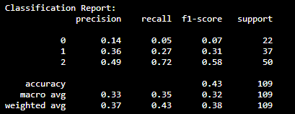

MobileNetV2

Slide 18
EfficientNet-B0

Slide 19
ResNet18

Slide 20
Conclusion for stag2
Future Improvements:
Stronger data augmentations.
More data for the dog(Age, types...)
Addition of an attention mechanism.(focused on some part of the dog’s face...)
Model ensembling to combine models together.

Slide 21
Thank you

